Slide 1
Data Analyst case study for a mobile application
Monica Kulkarni

Slide 2
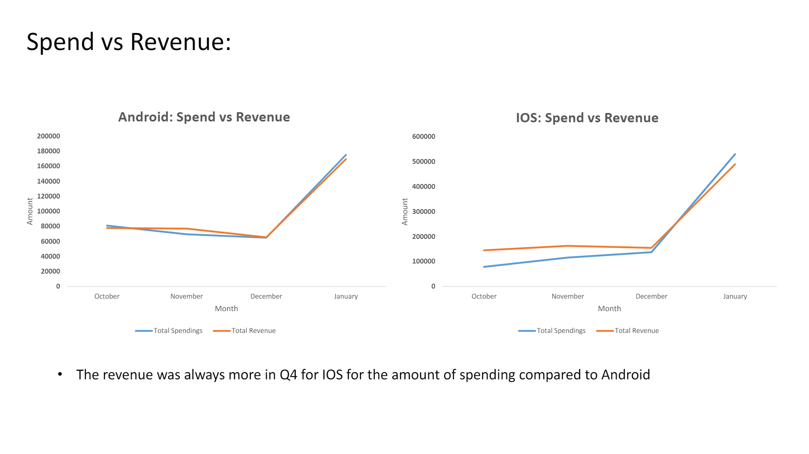

Slide 3
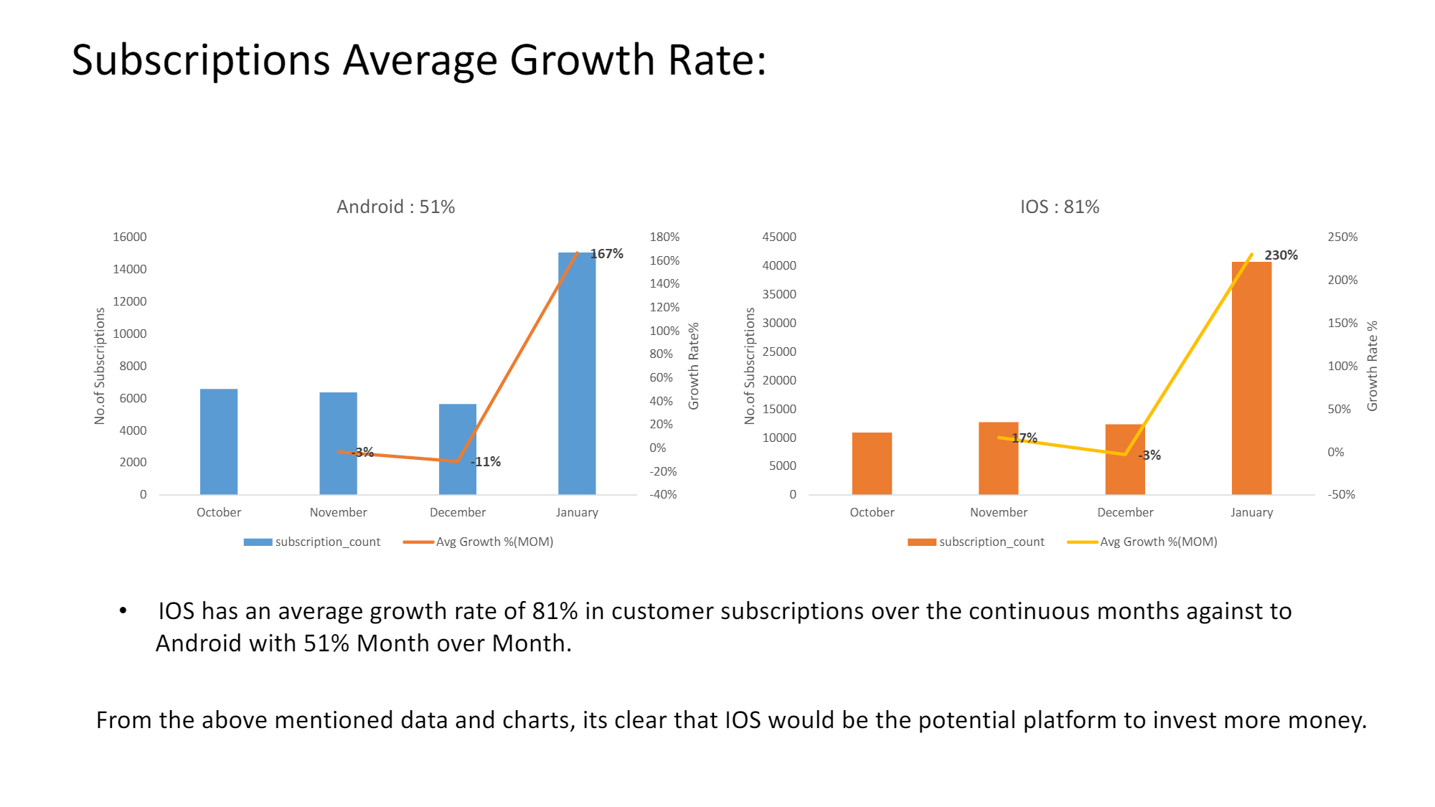

Slide 4
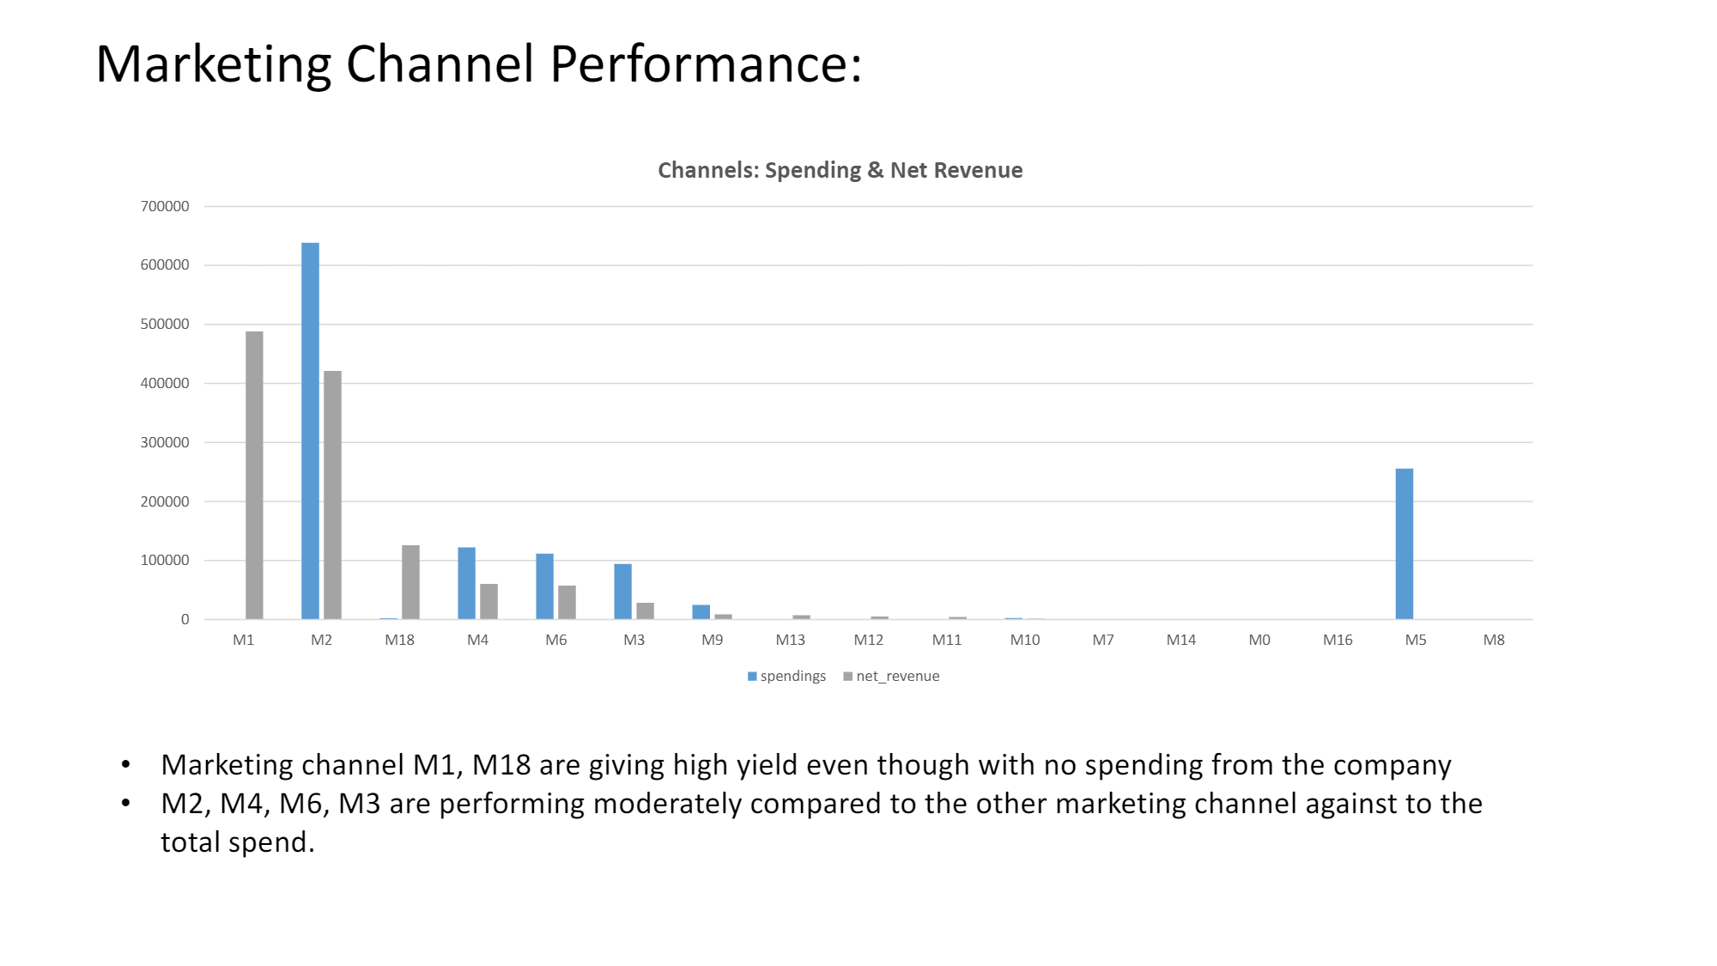

Slide 5
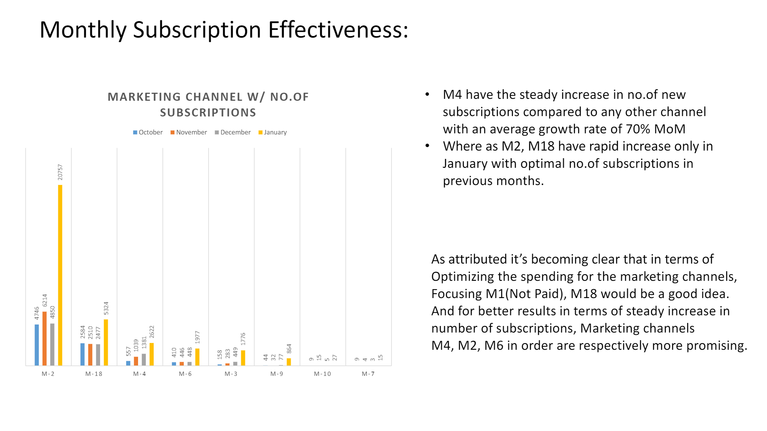

Slide 6
